Slide 1


Marketed By -
RAKSSHITA FOODS PVT LTD
Manufactured By –
Om Sai Annapurrnaa Bakery

Slide 2

Introduction
Overview of Raksshita Food Pvt Ltd
Current Modus Operandi
Strategic Partnership
Institutional Sales
Export Opportunities
D2C Scope
Conclusion and call to action

Slide 3
Company Overview
Founded in 2021, iBerlin is a dynamic and fast-growing company offering an extensive range of Pan-Asian food products to the Indian market. Established by Mr. Rajneesh Mishra and Mrs. Bharti R Mishra, the brand is built on passion, insight, and a deep understanding of India’s diverse culinary landscape.
With a solid banking and Food/Beverages background, Rajneesh travelled to almost every nook and corner of India during his career. These journeys helped him understand regional preferences, flavor profiles, and the evolving tastes of Indian consumers. His love for food and his understanding of the market inspired him to venture into the food industry and create I Berlin—bringing authentic Asian flavors to Indian kitchens.
Today, iBerlin proudly supplies a wide variety of premium Pan-Asian products to most of the top brands including MNCs in food and hospitality sector, known for consistency, quality, and authenticity.
With increasing consumer acceptance and demand for global cuisines, iBerlin is now ready to enter the D2C segment with a range of ready-to-use Pan-Asian products designed for modern consumers who seek convenience without compromising on taste.
Looking ahead, iBerlin is also geared toward exploring global markets, supported by plans to expand production capacity with state-of-the-art manufacturing technology and advanced machinery. This commitment ensures the company is prepared to meet both domestic and international standards with excellence.
At iBerlin, the vision is simple yet powerful:
To bring authentic Asian flavors to every kitchen while continuously innovating, expanding, and delivering world-class Indian Products.

Slide 4
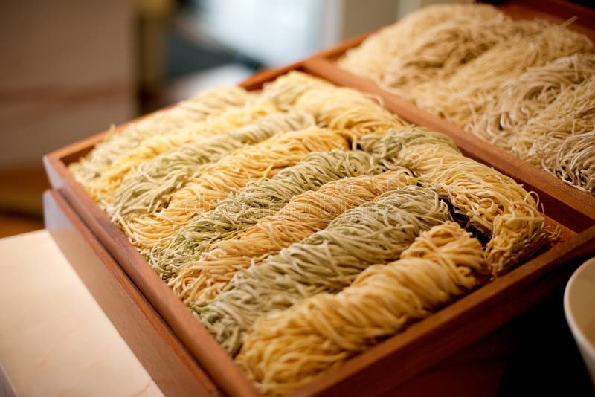
iBerlin Product Range
Premium Noodle Selection -
Elevate your dishes with our premium noodles collection, featuring a range of options.
Choose from round noodles in 1 mm, 1.2 mm, and 1.5 mm thicknesses, or opt for the delicate flat noodles available in 1 mm and 1.2 mm in fresh, frozen and dehydrated variant.
1.2 MM Round -Spicy Noodles White and Yellow.
Unleash your culinary creativity with these versatile noodles.

Slide 5

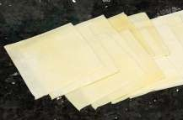
iBerlin Product Range
Artisanal Dimsum Sheets - Round Bliss
Elevate your dishes with our premium noodles collection, featuring a range of options.
Choose from round noodles in 1 mm, 1.2 mm, and 1.5 mm thicknesses, or opt for the delicate flat noodles available in 1 mm and 1.2 mm in fresh, frozen and dehydrated variant.
1.2 MM Round -Spicy Noodles White and Yellow.
Unleash your culinary creativity with these versatile noodles.
Wonton Elegance - Square 4"x4“ -
Transform your appetizers into works of art with our square wonton wrappers. Whether you prefer the classic white or the vibrant yellow, these 4" x 4" wrappers provide the perfect foundation for your wonton masterpieces. Create stunning bites that captivate both the eyes and taste buds.

Slide 6
iBerlin Noodles Quality Classification Criteria
Raw Material Quality
High-quality wheat flour – Key for good texture.
Additives – No artificial preservatives .
Water quality – Soft water preferred for smoother texture.
2. Production Method
Fully Automated plant – Consistent in Hygiene & highest quality.
Low-temperature drying – retains flavor and nutrition better than high-temperature drying.
3. Texture & Cooking Behavior
Elasticity – Chewy yet tender .
Non-sticky – Noodles don’t clump after cooking.
Cooking tolerance – Doesn't overcook easily, maintains integrity.

Slide 7
4. Appearance
Uniform color and shape.
No specks, cracking, or excessive flour residue
For egg noodles, should have a golden hue from real eggs, not coloring.
5. Taste & Aroma
Mild wheat or rice flavor when plain.
No chemical or sour aftertaste.

Slide 8



















Overview of Raksshita Food Pvt Ltd
Company has established it’s credibility in HoReCa channel as Distributor and Marketing partner for Om Sai Annapurrnaa PAN-Asian products, company showcases strong growth and resilience in a competitive market.
Our esteemed Client

Slide 9


Institutional Sales
Exploring the landscape of institutional Demand and Export
Institutional sales represents a significant revenue stream.
Government Institutes
Export
Sales Strategy
Tailored sales approach geared towards budling long term partnership with organizations, ensuring alignment with the procurement strategies

Slide 10

Marketed By -
RAKSSHITA FOODS PVT LTD
Manufactured By –
Om Sai Annapurrnaa Bakery

